Slide 1
RUGBY OFFICER CHECKLIST
2023-24

Slide 2
To navigate, open as a presentation.
To move to the required page, click on the appropriate tile box
PRE SEASON
To return to the index page, click on the Index box
Index
To scroll through use left or right cursor buttons as per any normal presentation

Slide 3
PRE SEASON
H&S
AFFILIATION & ACCREDITATION
CONSTITUTION
GMS
(OVERVIEW)
GMS
LINKS
COMPETITION ENTRY
ALTERNATE FORMAT
RUGBY
AS EARLY AS POSSIBLE
BOOK FACILITIES
BOOK REFEREE
BOOK FOOD
TRANSPORT REQUEST
72/48 HRS PRE MATCH
CONFIRM OPPOSITION
CONFIRM REF
CONFIRM FACILITIES
REGTL ORDERS
EQPT CHECK
MATCH DAY
PITCH & FACILITIES INSP
GREET REF & OPPOSITION
POST MATCH
EQPT CHECK
INJURY REPORTING
RESULT – CONFIRM WITH REF
MATCH REPORT
MISC
TOURING

Slide 4
PRE SEASON
H&S
Unit should have an existing Risk Assessment that is signed and agreed by Unit SHEF manager and CO.
ARU Website - Generic Risk Assessment.
Ensure players and match officials have access to RA
Where possible, units should have trained Pitch side First Aiders – RA must reflect if this is not the case and how the unit mitigates the risk.
Pitch side first aider courses are run throughout the season. ROs will be informed of when these are run by the ARU.
ARU website details all additional H&S measures such as concussion training and post match injury reporting HERE.
Index

Slide 5
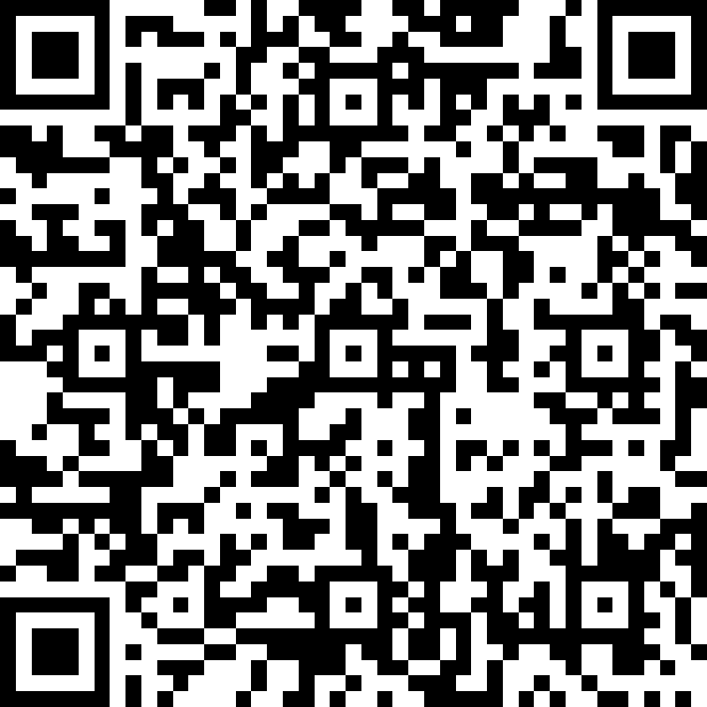
PRE SEASON
AFFILIATION & ACCREDITATION
Affiliation
Units and Corps have to affiliate for insurance purposes.
Affiliation is required even if the unit only play inter Regimental matched.
Payment must be made via BACS.
Affiliation can be completed here or by using the following QR code:
Accreditation
All Corps must complete Accreditation Self Assessment (found here ) and submit to Dir of Community for review (Email to marc.wilding962@mod.gov.uk)
Corps are to conduct an annual review of Accreditation with Dir of Community rugby.
Index

Slide 6
PRE SEASON
CONSTITUTION
Units & Corps are advised to write a Constitution.
All civilian clubs, as members of the RFU must have a constitution.
A draft Constitution can be found on the ARU webpage.
All military ‘clubs’ ie those that have more than one team (such as Corps) should ensure that there is a reference to all of the teams that they manage (ie Masters, Women’s or Dev teams)
Index

Slide 7
PRE SEASON
GMS
OVERVIEW
GMS (Game Management System) is the RFU’s principal tool for managing the community game.
All pers involved (RO, Team Manager, Coach, Players) must be registered on GMS.
People can be registered in multiple roles and teams – they should only have one GMS account however.
Players should be placed as ‘unregistered’ against all mil teams – this ensures that there is no conflict if they also play civilian rugby.
It is the responsibility of ROs and Team Managers to ensure that all players are registered to ensure that Electronic Match cards are accurate.
Index

Slide 8
PRE SEASON
GMS
LINKS
Create a GMS account Here
Add people to GMS Here
Assigning and removing roles Here
Assigning Coach & Team Manager roles Here
Fixture FAQs Here
Electronic Match Card guidance Here
Electronic Match Card Step by Step Guide Here
RFU GMS Site for help and guidance. Note, the GMS page does not work well with Mil IT networks.
Index

Slide 9
PRE SEASON
COMPETITION ENTRY
Ensure you or a delegate attend the ARU Community Rugby AGM
Determine level of competition that you believe your team should play at. Use Chair Unit Rugby as a sounding board if required.
If there is an intent to play league or competition rugby, ensure that you fully understand Regtl FOE before committing to matches. Deconflict against all major trg events/deployments.
Submit confirmed fixture date availability to League/Competition sec within given timeframe.
Top Tip – set up a process for player availability so that you know when and where all interested players are in good time.
Index

Slide 10
PRE SEASON
ALTERNATE FORMAT RUGBY
If XVs is a difficult format to replicate then ROs should consider alternate means of facilitating competitive rugby.
Mini short format tournaments (such as 7s, 10s or 12s) should be considered.
A template competition AI can be found on the defence Connect ARU Community Rugby page Here
Index

Slide 11
PRE SEASON
BOOK FACILITIES
AS EARLY AS POSSIBLE
H&S
Home Rugby Officers are responsible for ensuring that pitches and suitable changing areas are booked in advance.
Remember that in larger Garrisons that facilities are shared, do not assume pitches are free, book them in advance.
Ensure that visiting team and referees changing facilities are booked in advance and that they know where to report.
Index

Slide 12
BOOK REFEREE
PRE SEASON
AFFILIATION
AS EARLY AS POSSIBLE
ARU Website - Book a Ref
All Army Rugby Union (ARU) registered clubs will have appointed referees from the Army Rugby Union Referees Society (ARURS) promoting the core values of the sports both on and off the field of play.
If the game is cancelled, the referee is to be informed immediately, failure may result in the travel and subsistence being claimed from your unit / organisation.
Premiership bookings: ian.farrell789@mod.gov.uk
South & Wales bookings: arurs-appts-s@hotmail.com
North & NI bookings: arurs-appts-n@hotmail.com
Europe and wider bookings: Roy.Serevena591@mod.gov.uk
Index

Slide 13
PRE SEASON
CONSTITUTION
AS EARLY AS POSSIBLE
BOOK FOOD
Post match hospitality is encouraged, however, we do understand that this must be provisioned by the home team.
In the past, ROs have been able to apportion Regimental funds for post match food, as part of their financial budget.
Home teams should confirm with opposition as to whether they would like to be catered for to avoid any unnecessary costs.
Index

Slide 14
PRE SEASON
TRANSPORT REQUEST
AS EARLY AS POSSIBLE
GMS
For ARU Competition Finals and Semi Finals, units may use POT 16 for travel
For all other matches (friendlies, league matches) this is not applicable.
Where possible, ROs should ensure that transport is pooled (ie players sharing) and that it is appropriate. There has been an influx of players reporting to Corps rugby in expensive hire cars – this is a practice we do not want to replicate in unit rugby!
Index

Slide 15
PRE SEASON
H&S
72/48 HRS PRE MATCH
CONFIRM OPPOSITION
Contact opposition RO to confirm fixture.
If the fixture is in doubt due to player numbers, look for alternate ways to play the fixture – 12s, 10s, Return2Rugby adaptive scrum laws (if there is a lack of Front Row)
If the nature of the match has changed, ensure referee is notified when you confirm with them.
Index

Slide 16
CONFIRM REF
PRE SEASON
AFFILIATION
48 HRS
Contact the nominated referee at least 48 hours prior to the game, to confirm availability, pitch location, kick-off time, playing strips of both teams and any relevant competition regulations.
If the game is cancelled, the referee is to be informed immediately, failure may result in the travel and subsistence being claimed from your unit / organisation.
There are some VERY senior officers in the referee cohort. If a game is cancelled and the referee is not notified, you run the risk of this being a very senior officer who is likely to drop a note to your Commanding Officer. Please do not fall foul to this!
Index

Slide 17
PRE SEASON
CONFIRM FACILITIES
48 HRS
CONSTITUTION
Follow up on initial facilities booking! Pitches, changing facilities, transport, food etc.
Confirm whose responsibility it is to dress the pitch (post protectors and flags) if you book via Aspire/civilian contractors.
Index

Slide 18
48 HRS
PRE SEASON
GMS
REGTL ORDERS
Regimental Orders MUST be updated with match details for insurance purposes.
Detail should include date, opposition, venue, timings, personnel and responsibilities.
Details of personnel selected at Representative level (Army & Corps) must also be included on Regimental Orders.
Index

Slide 19
48 HRS
PRE SEASON
EQPT CHECK
Match day strip, post protectors, flags, training equipment, match balls, first aid kit etc should be checked in advance to ensure that they are serviceable.
Index

Slide 20
MATCH DAY
PRE SEASON
H&S
PITCH & FACILITIES INSP
Most pertinent when playing on pitches within Garrison areas that are outside of camp.
Ensure pitch is playable, free from foreign objects and that there is clear access and egress in the case of a med emergency.
Ensure changing facilities have been allocated to away team and referee.
Ensure Risk Assessment for pitch and facilities has been passed to the ARU.
Index

Slide 21
MATCH DAY
GREET REF & OPPOSITION
PRE SEASON
AFFILIATION
Ensure both Referee and Opposition are made aware of changing facilities, pitches and access routes (if applicable).
Index

Slide 22
PRE SEASON
EQPT CHECK
POST MATCH
H&S
Make sure all match kit is accounted for!
Check that all pitch equipment (post protectors, flags and poles) are serviceable.
Index

Slide 23
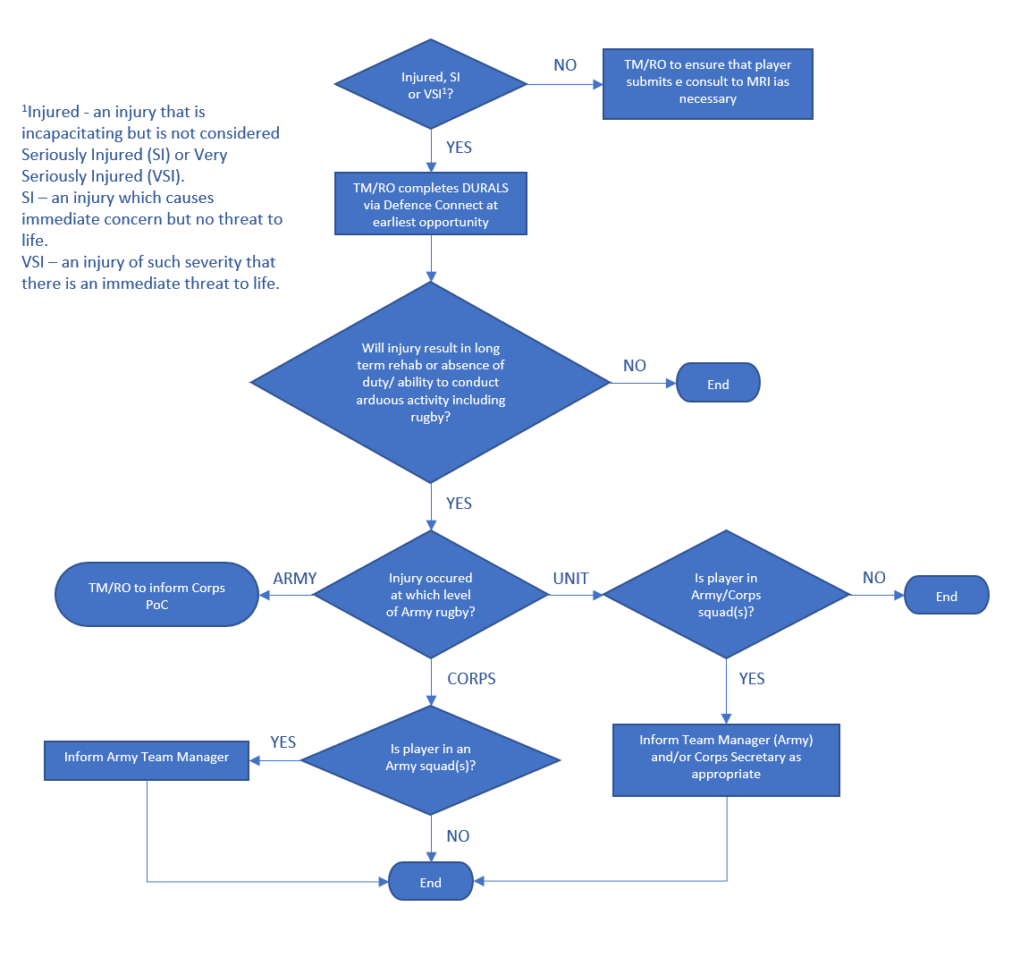
INJURY REPORTING
PRE SEASON
AFFILIATION
POST MATCH
If players are injured whilst playing rugby then they may be liable for compensation.
JSP 765 is the authorative document that should be followed,
In order to claim, injured players should use DURALS (mil.uk) via the Defence Connect.
Concussion - What it is, how to deal with it: Bath Rugby - YouTube
Concussion Mgmt
Index

Slide 24
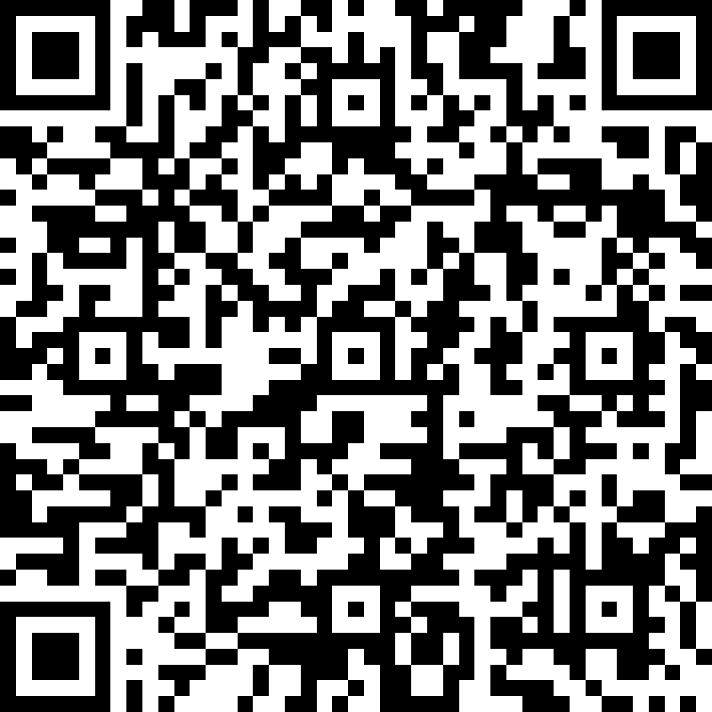
PRE SEASON
POST MATCH
RESULT – CONFIRM WITH REF
For the 2022/23 season, ARURS referees have been asked if they could complete a match card for all fixtures.
Rugby Officers should check to see if this has happened and if not must ensure that results are passed to League Secretaries nlt 0900hrs the following day.
Match Cards can be filled out here. ROs should annotate their appointment by adding ‘(RO)’ after their name.
The following QR code can also be used:
Index

Slide 25
PRE SEASON
POST MATCH
MATCH REPORT
Match reports and photos of matches are highly desirable for inclusion on the Army rugby webpage and Community Rugby Social media channels.
Reports do not have to be long and exhaustive, please look to highlight good play and give credit to those that deserve it.
Don’t include ‘in’ jokes or nicknames if they are inappropriate.
Include players Instagram or twitter tags if they are happy for you to do so. Also look to tag in your unit’s social media channels for further exposure.
Index

Slide 26
MISC
TOURING
Touring is a superb way to grow Esprit de Corps and reward players and officials.
Guidance on touring can be clearly found on the ARU website Here
Policy for Overseas Tours
ASB Overseas sport tour instructions
Add tour details to the Army Situational Awareness Room (ASAR). The ASAR gives the Land Ops Cell situational awareness of where all our overseas activity is being held and over what period. Update Here
Index

